Slide 1
CVCoach
Your best CV assistant
Team 5

Slide 2
Overview
Requirement to Implementation
Software design
Software testing
Software security
Configuration and deployment
Project Management
Final demo

Slide 3
Requirement to Implementation

Slide 4
Resume Evaluation - User story
User Story: As a job seeker, I want to upload my resume and receive feedback on how well I match a specific job description, so that I can understand my strengths and areas for improvement to increase my chances of getting the job.

Slide 5
Resume Evaluation - User story
Acceptance Test:
Given: The user is on the resume upload page and has a resume in PDF format.
When: The user selects the PDF file and clicks the "Upload" button.
Then: The system should successfully upload the resume and display a confirmation message indicating the PDF file has been successfully uploaded.

Slide 6
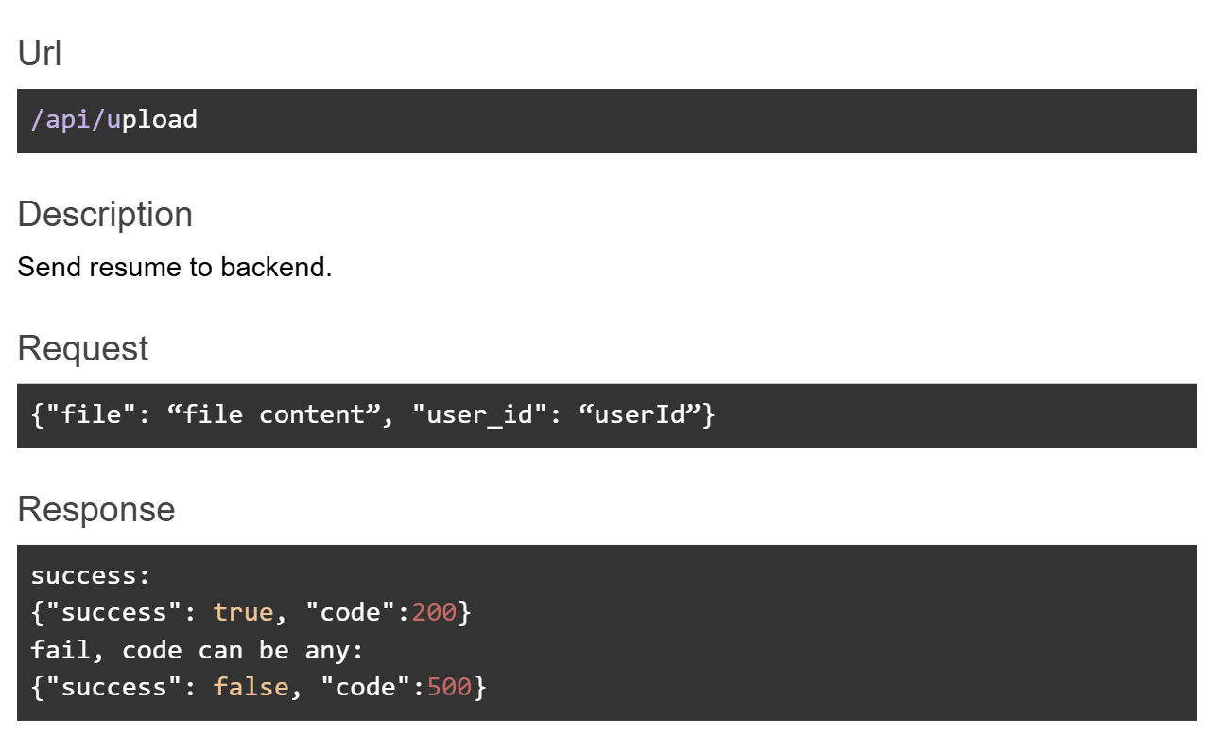
Resume Evaluation - API design

Slide 7
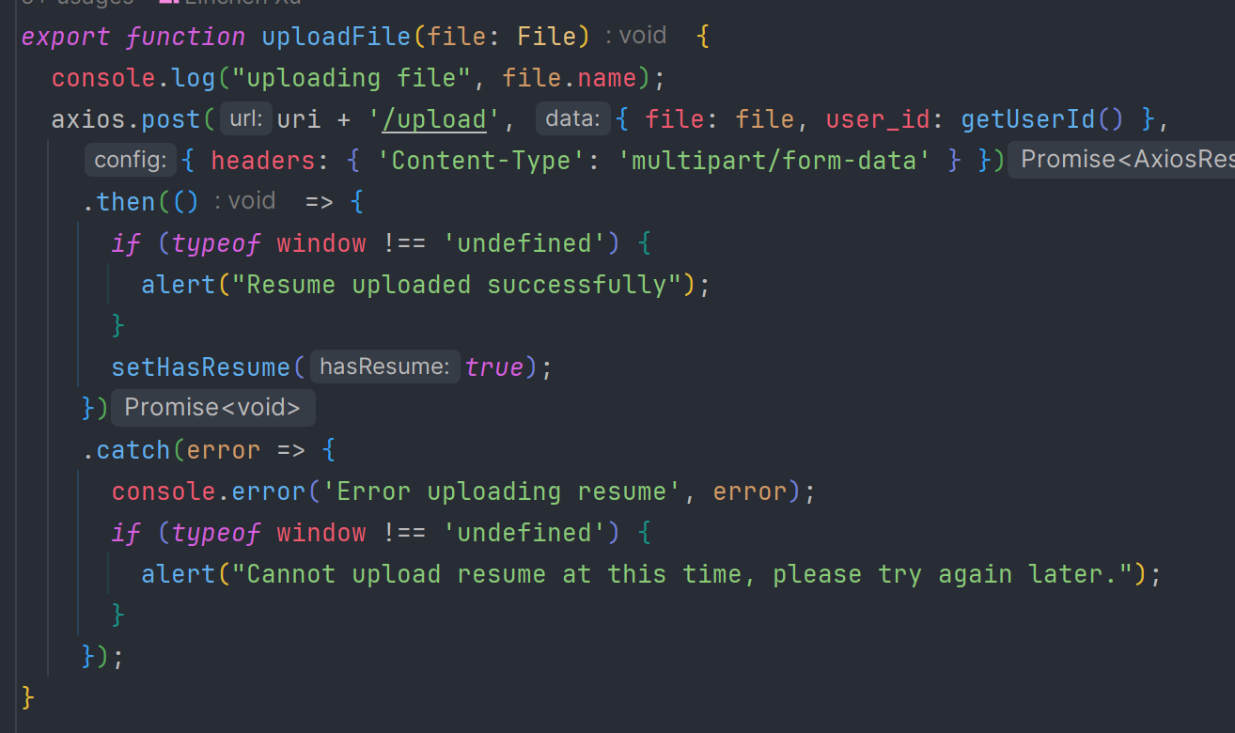
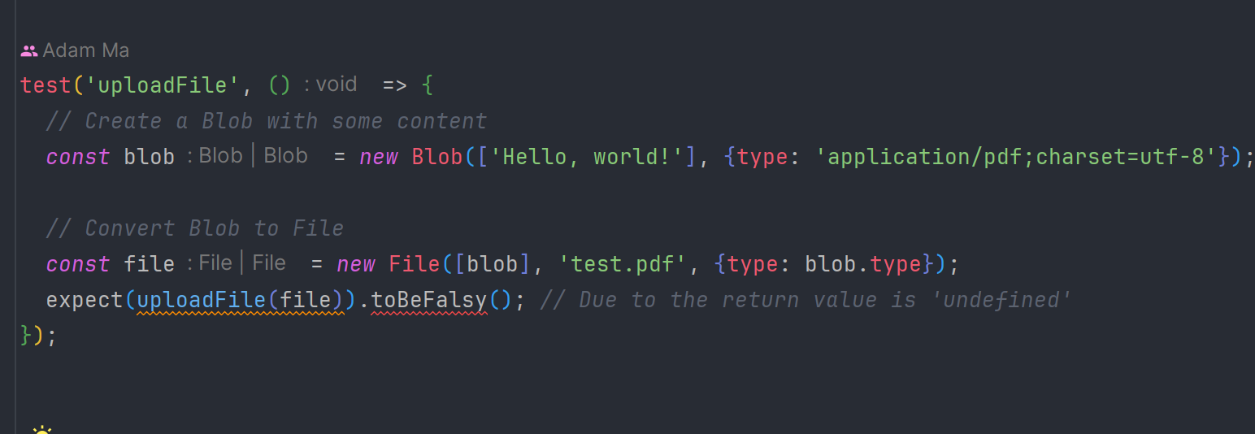
Resume Evaluation - Implementation

Slide 8
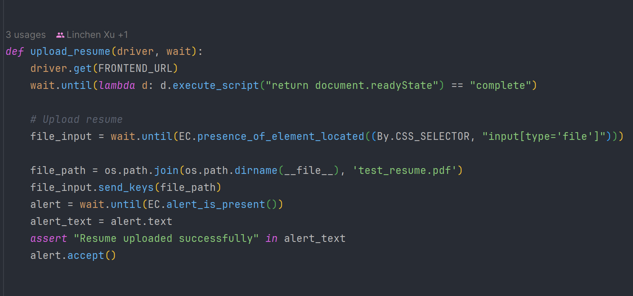
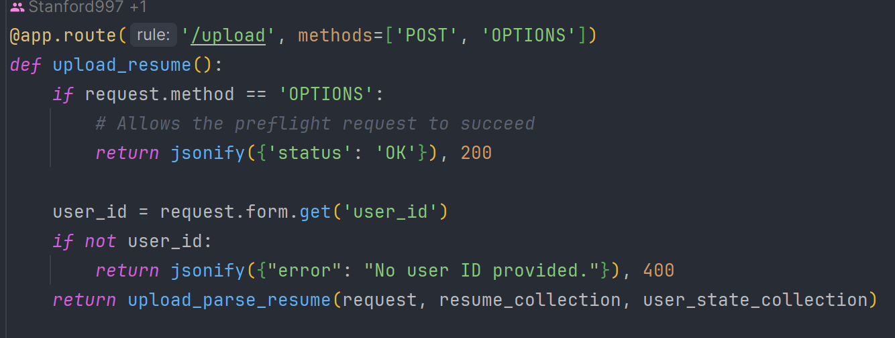
Resume Evaluation - Implementation

Slide 9
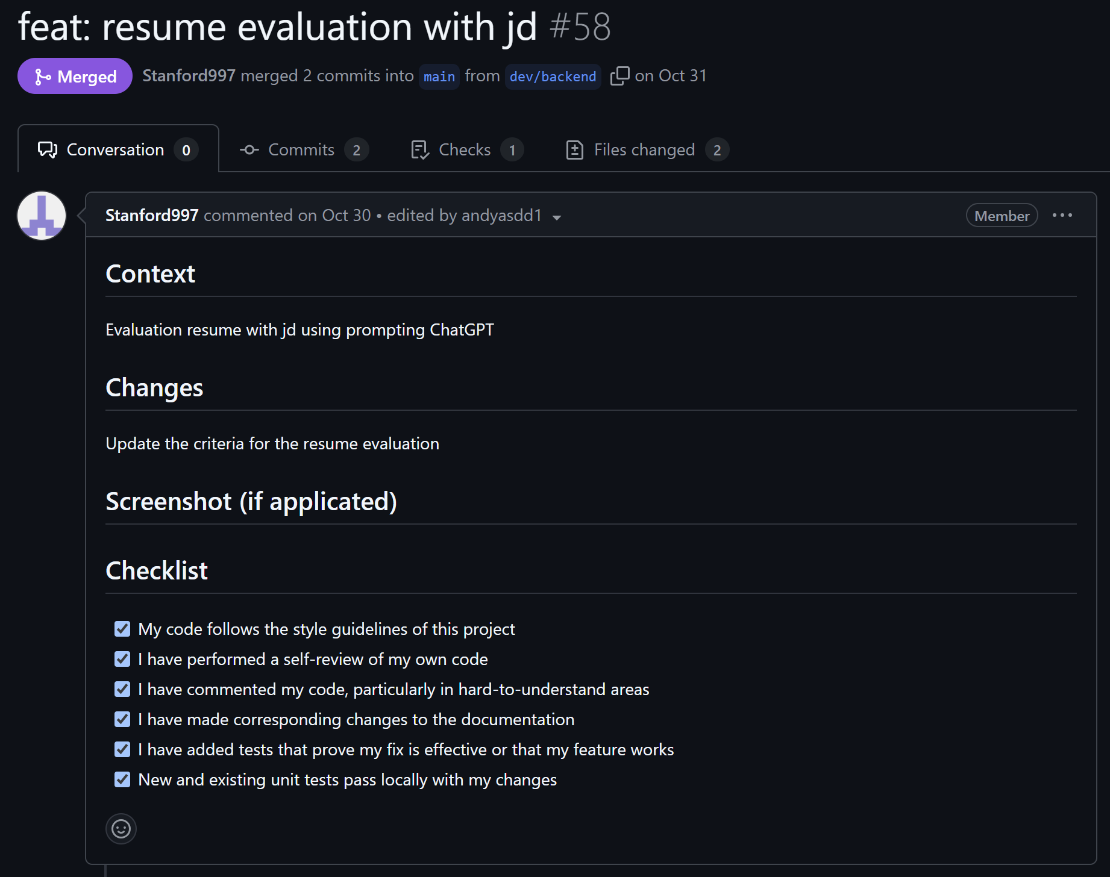
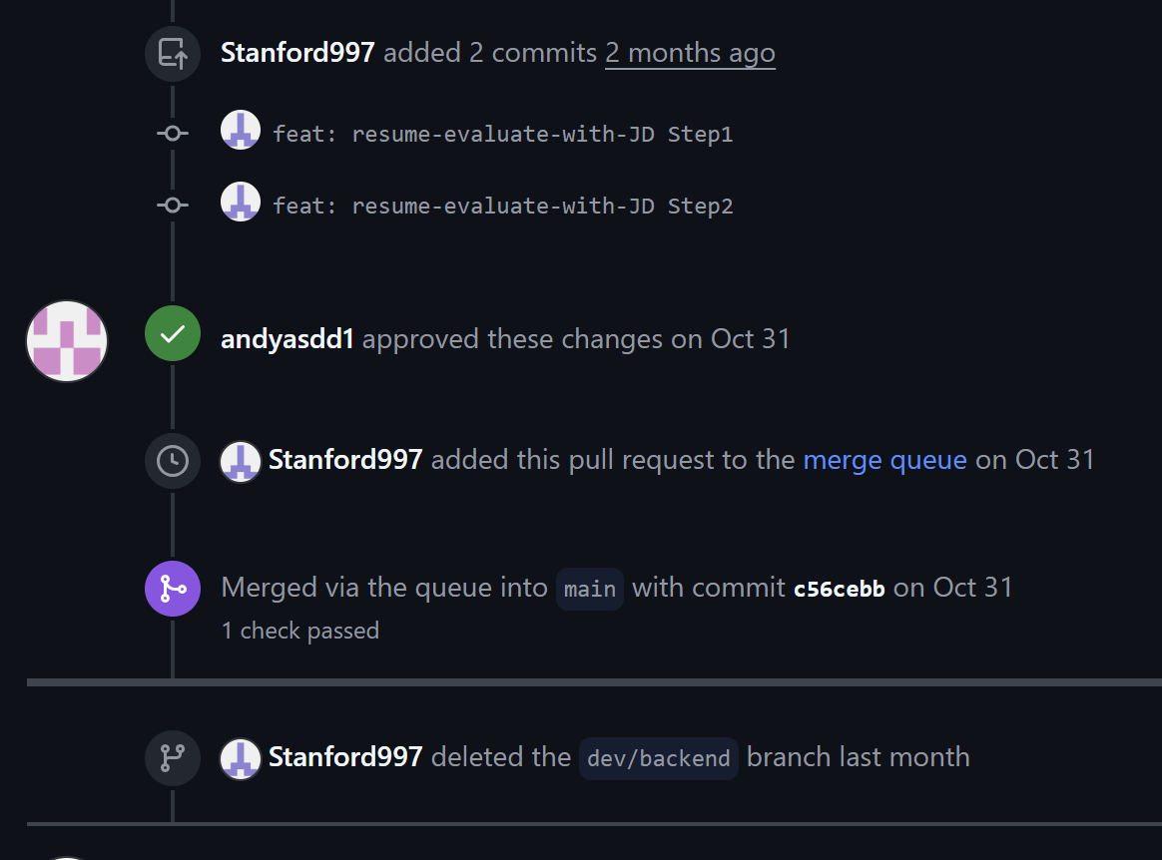
Resume Evaluation - Merge to main branch

Slide 10
Software design

Slide 11
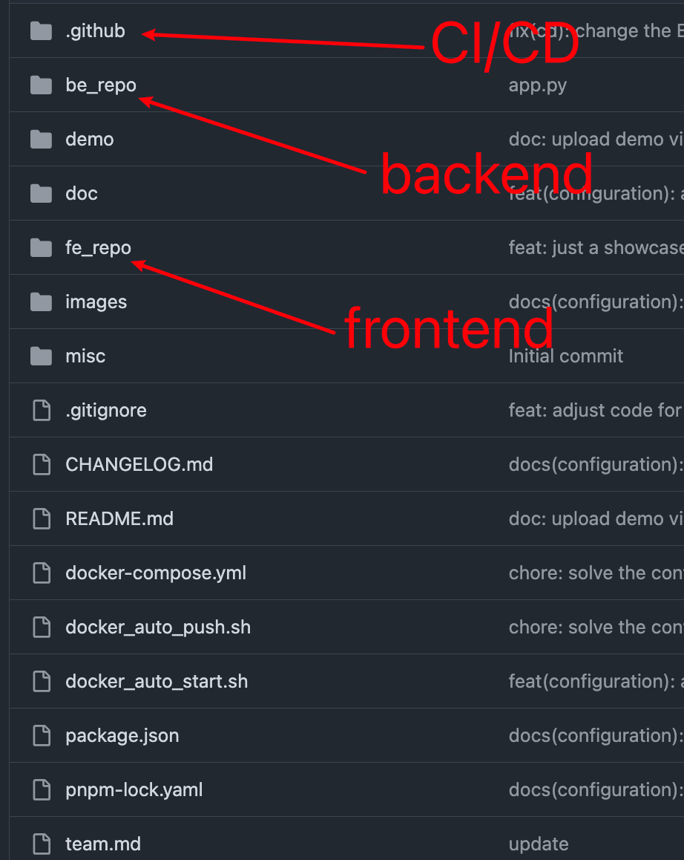
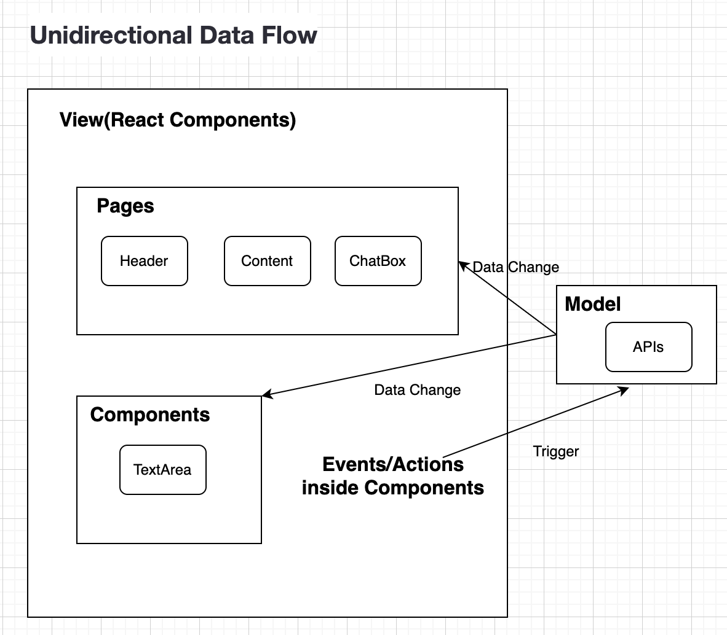
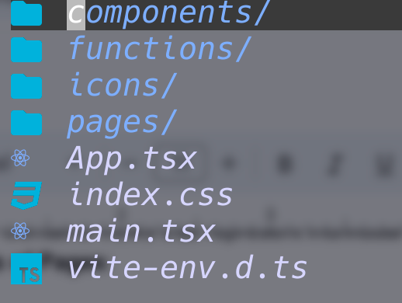
Software architecture - Frontend

Slide 12
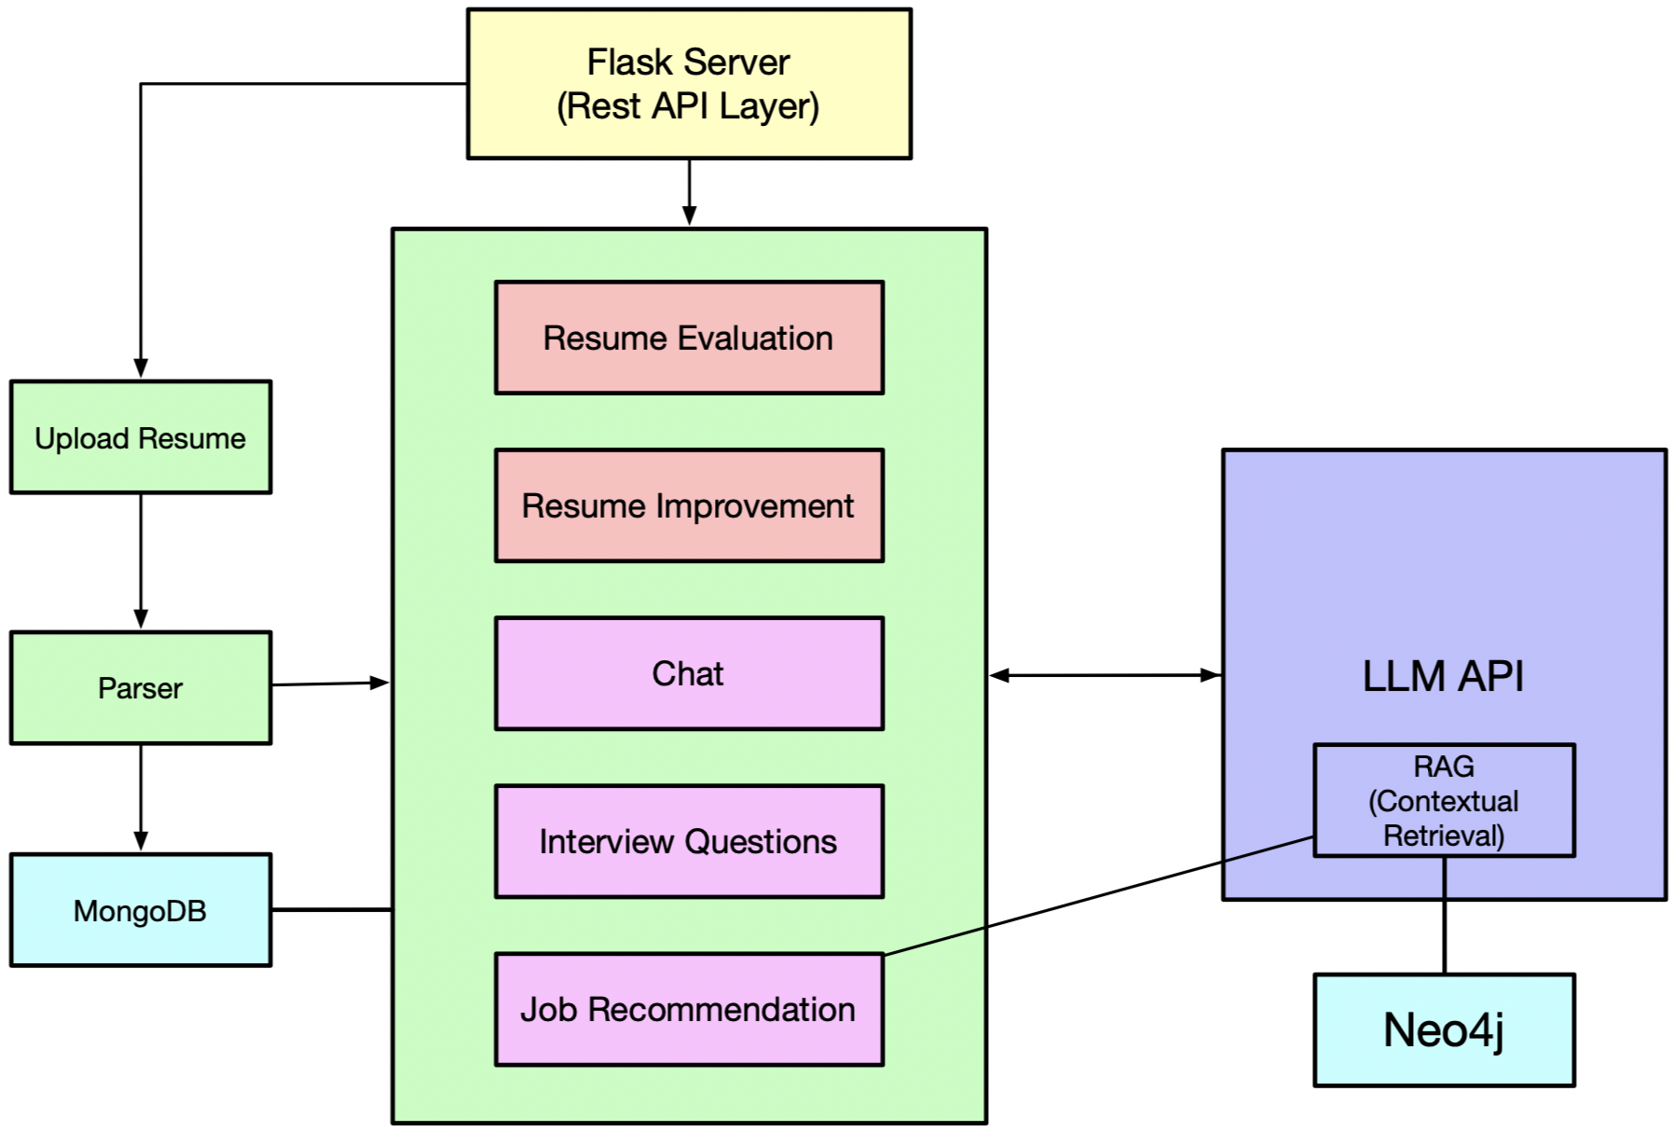
Software architecture - Backend

Slide 13
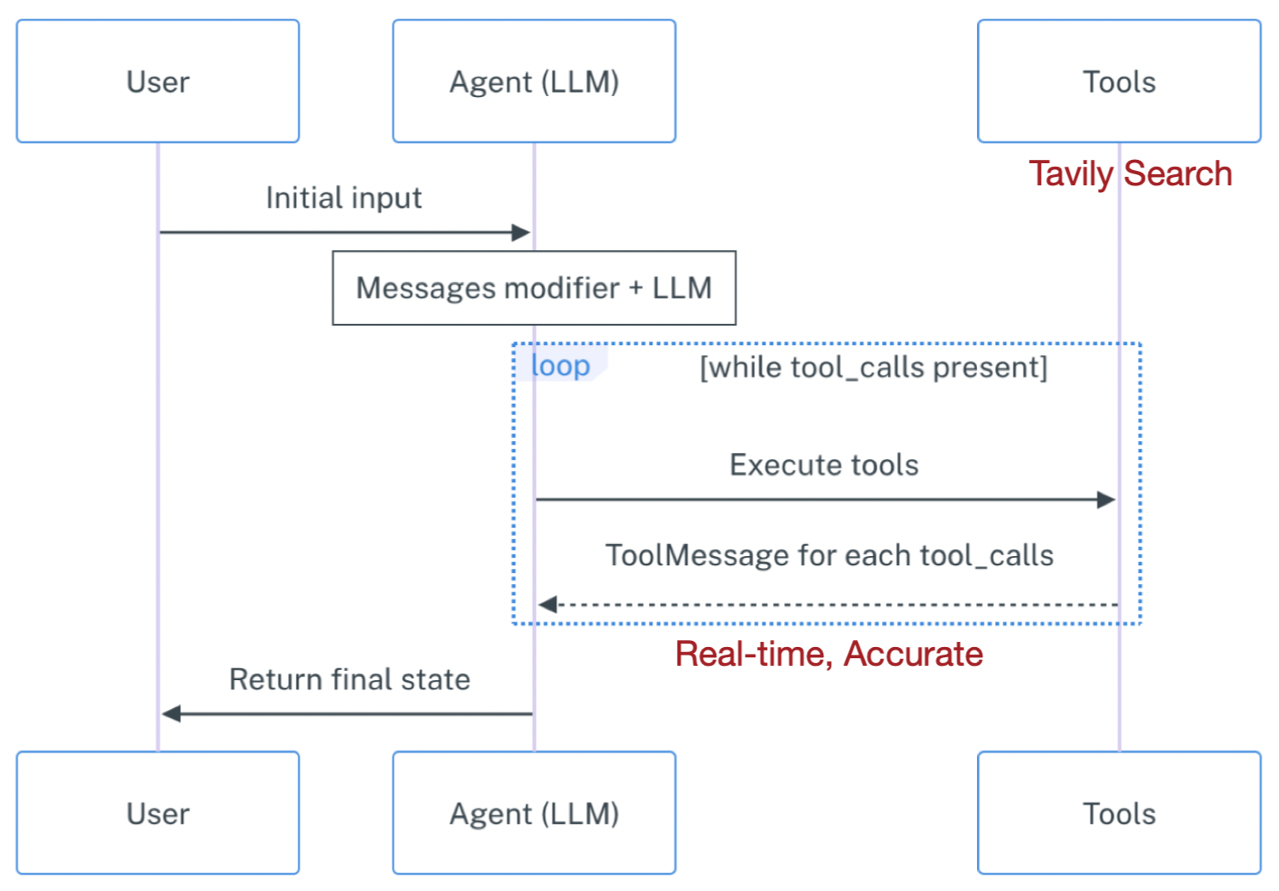
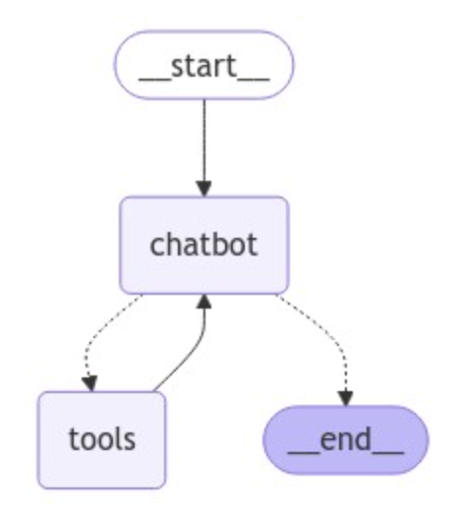
LangGraph - ChatBot

Slide 14
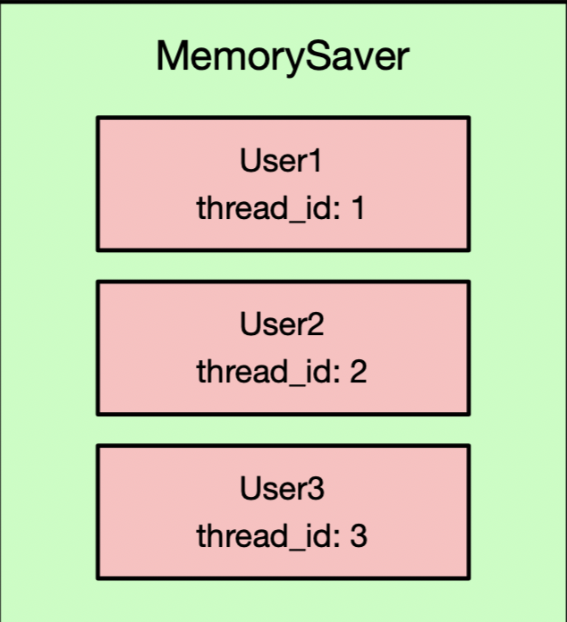
LangGraph - ChatBot

Slide 15
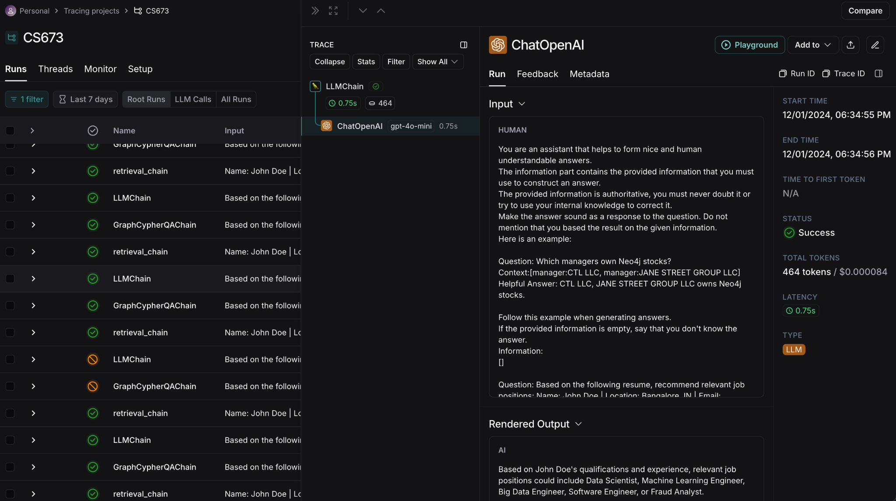
LangSmith - Monitor

Slide 16
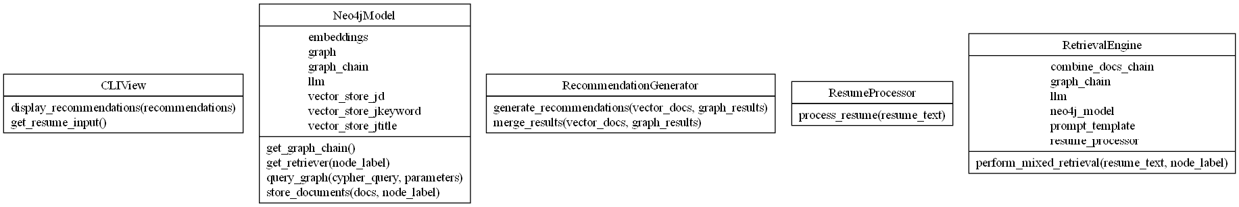

Job recommendation feature
Model, View, Controller.

Slide 17
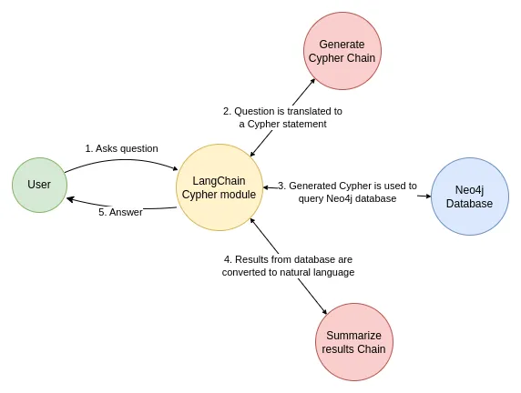
Q&A chain over a graph database and Mixed retrieval

Slide 18
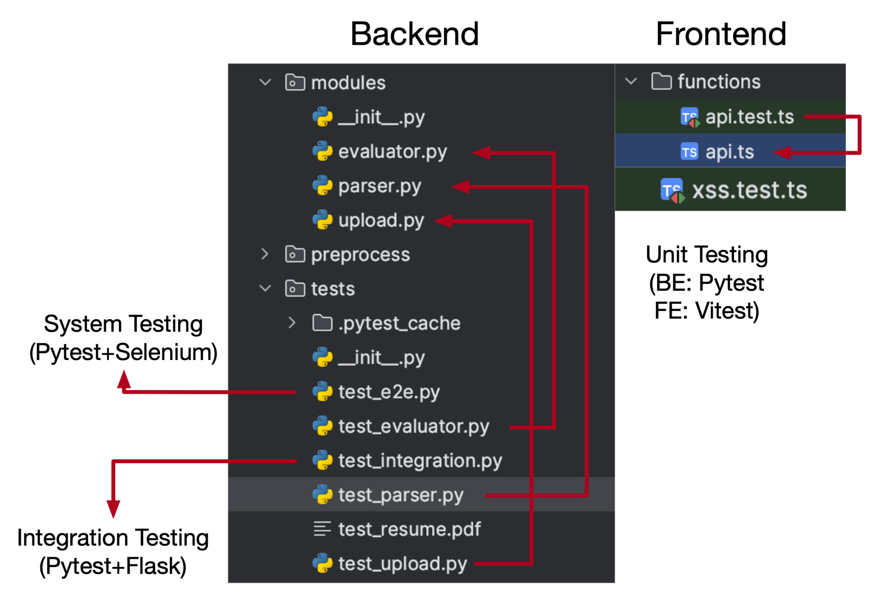
Software testing
Unit Testing
Integration Testing
System Testing
Regression Testing
Acceptance Testing

Slide 19
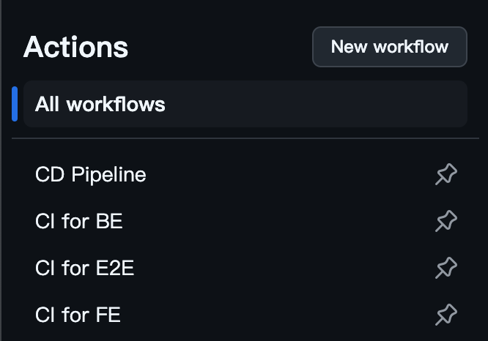
Automated Testing
Unit Testing
Integration Testing
System Testingng

Slide 20
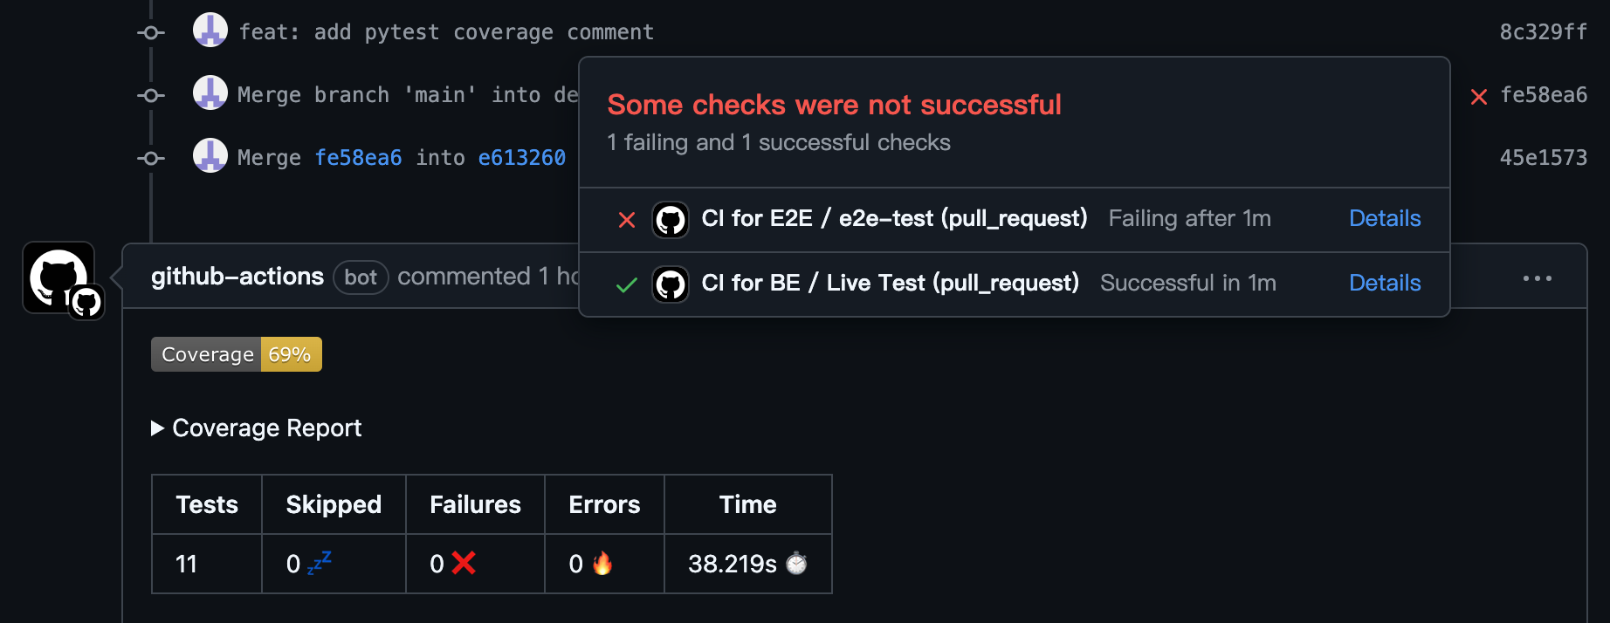
Pytest Coverage Comment

Slide 21
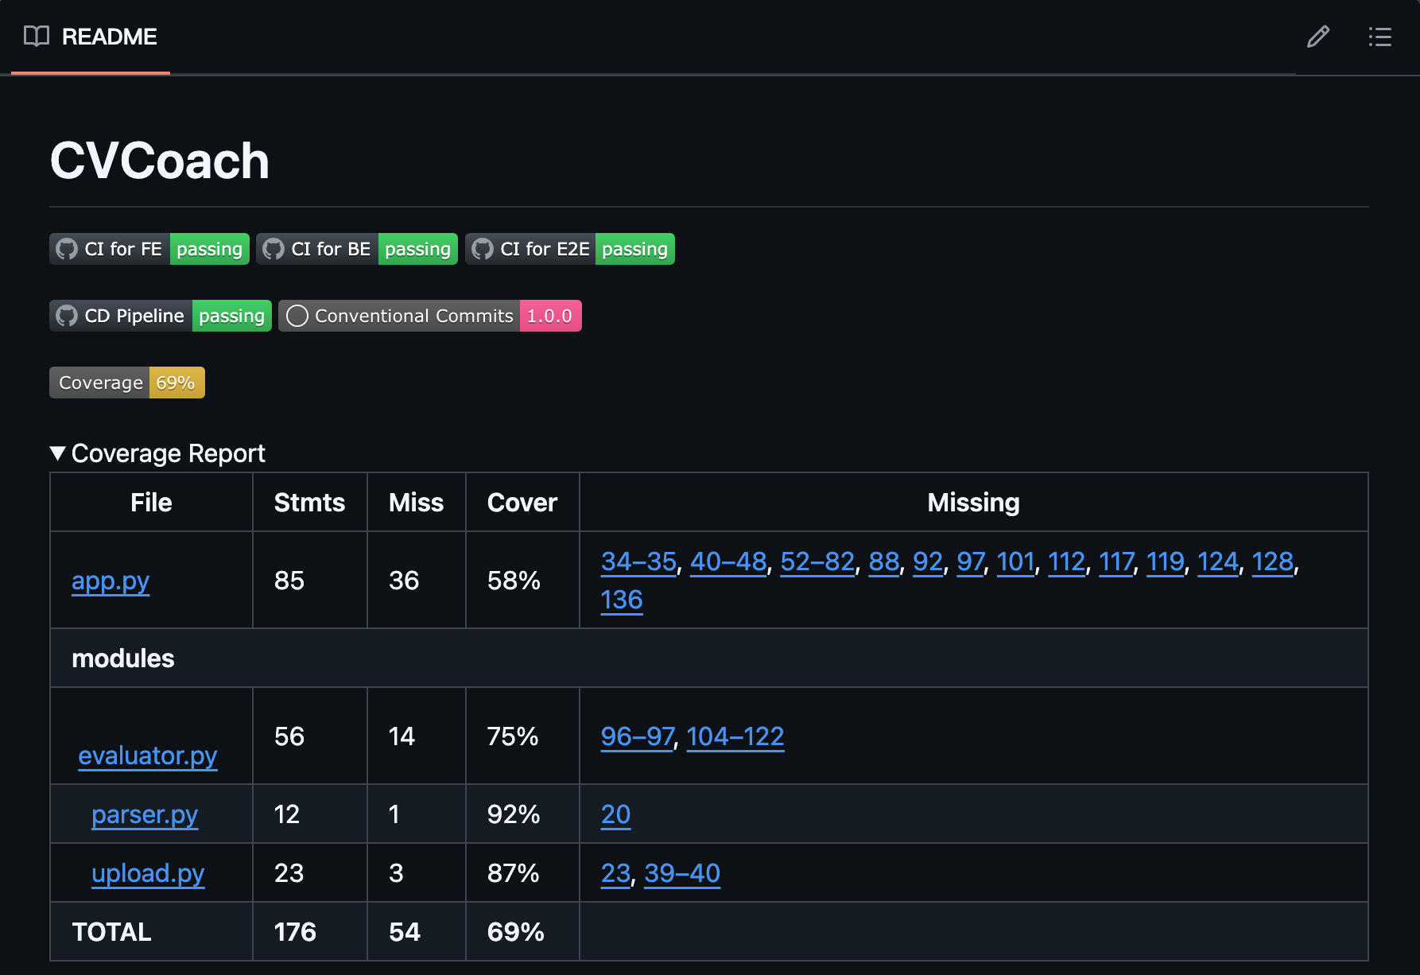
Auto Updating Badge and Report on README

Slide 22
Software security
Integration of Cloudflare to keep our DNS safe from attacks like DDoS
Dependencies checking (in CI)
Input filter, avoid the XSS attack.
Integrate automated testing tools into the CI/CD pipeline using CodeQL
Add push check for sensitive information
Utilize local filter to strip sensitive personal info before analyze.

Slide 23
Configuration and deployment
Lint rules
Git Conventional Commits + CHANGELOG.md
Docker
Templates of Github issue and PR
CI / CD pipelines
Cloud Service: GCP EC2
Domain + Cloudflare (Network protection)
Google Adsense, Google Analytics, Google Ad manager

Slide 24
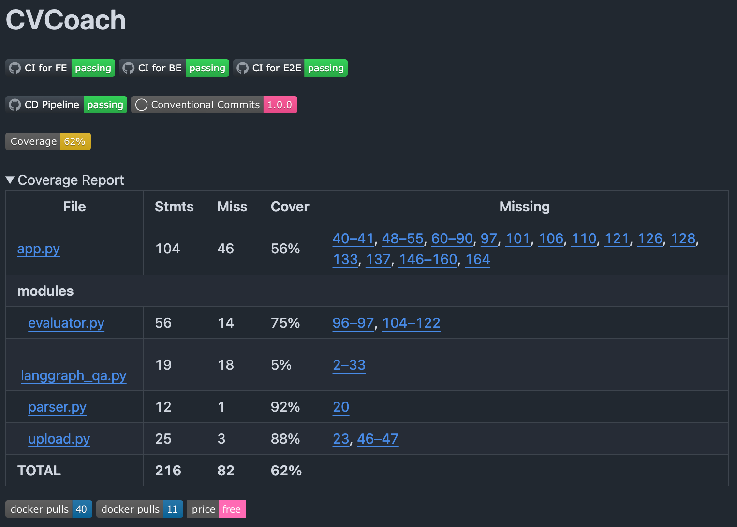

Slide 25
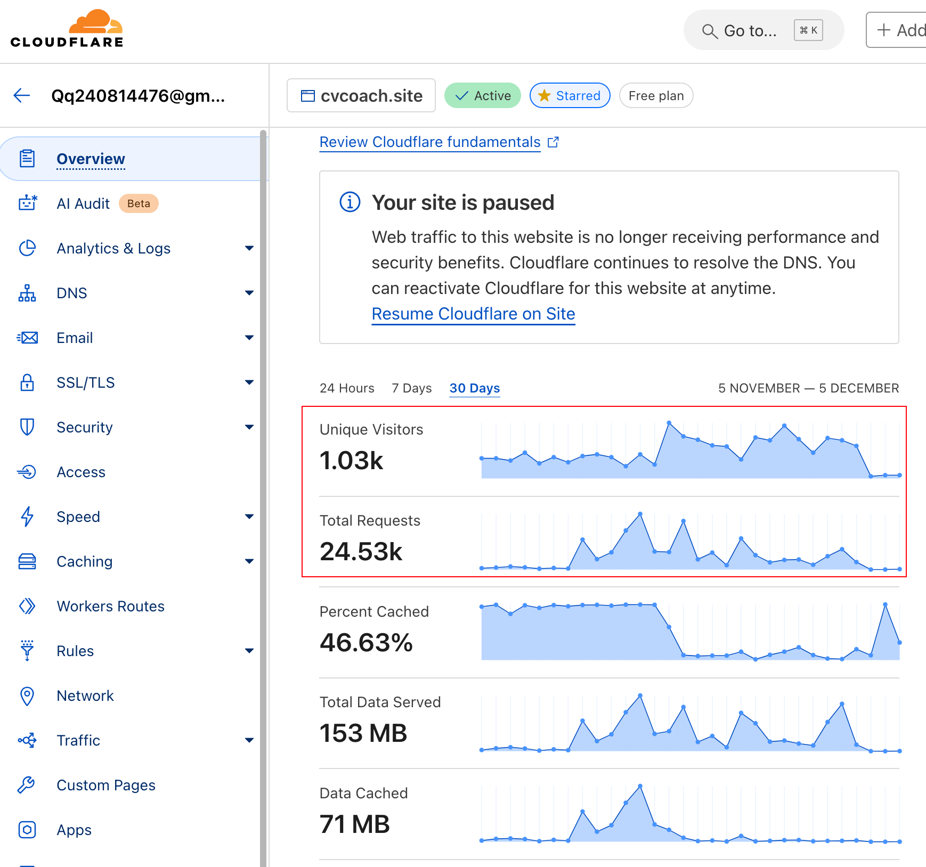
How to leverage these visitors?

Slide 26







Slide 27
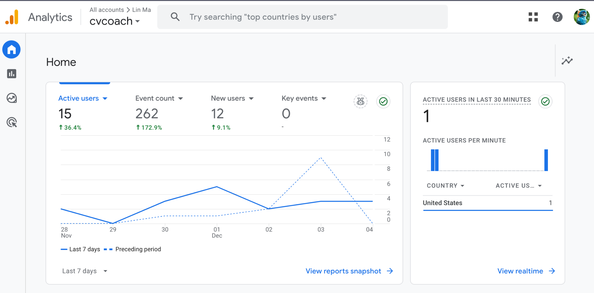

Slide 28


zellij

Slide 29
Project Management

Slide 30
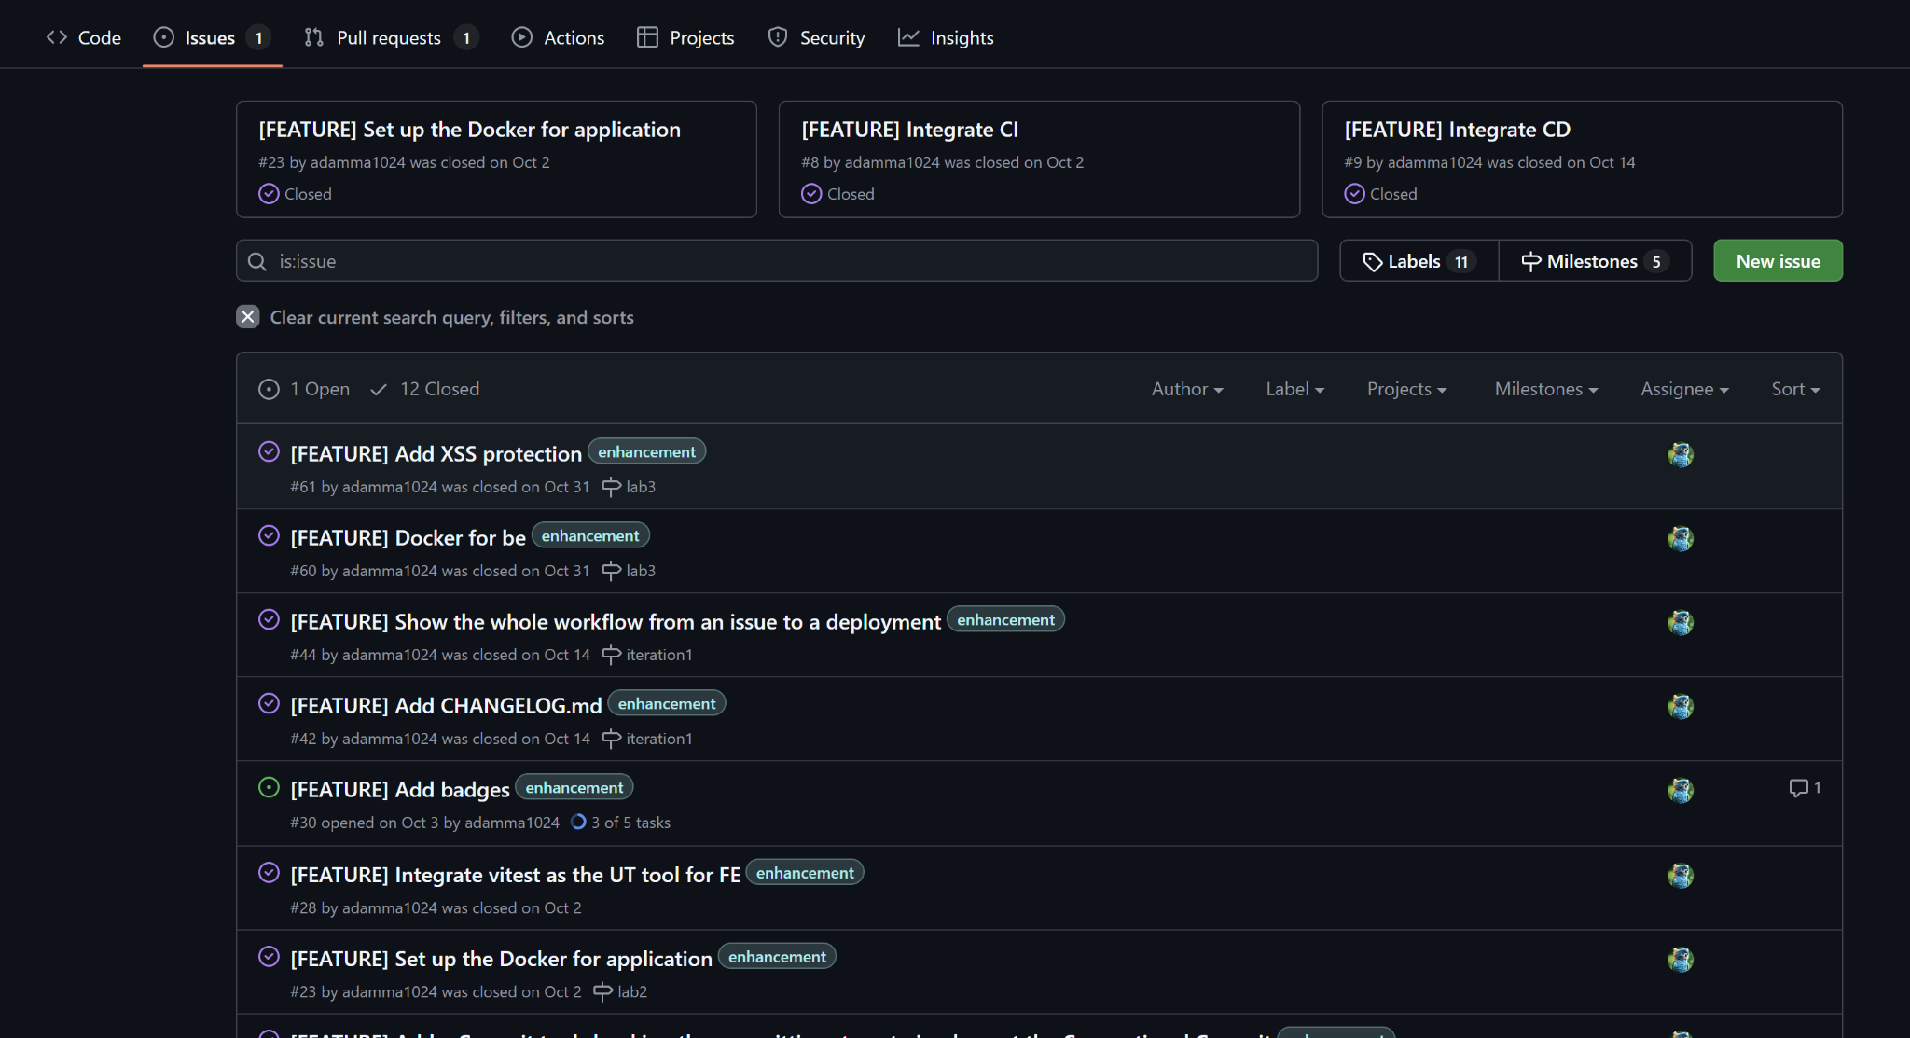
Issues
Closed 12 issues

Slide 31
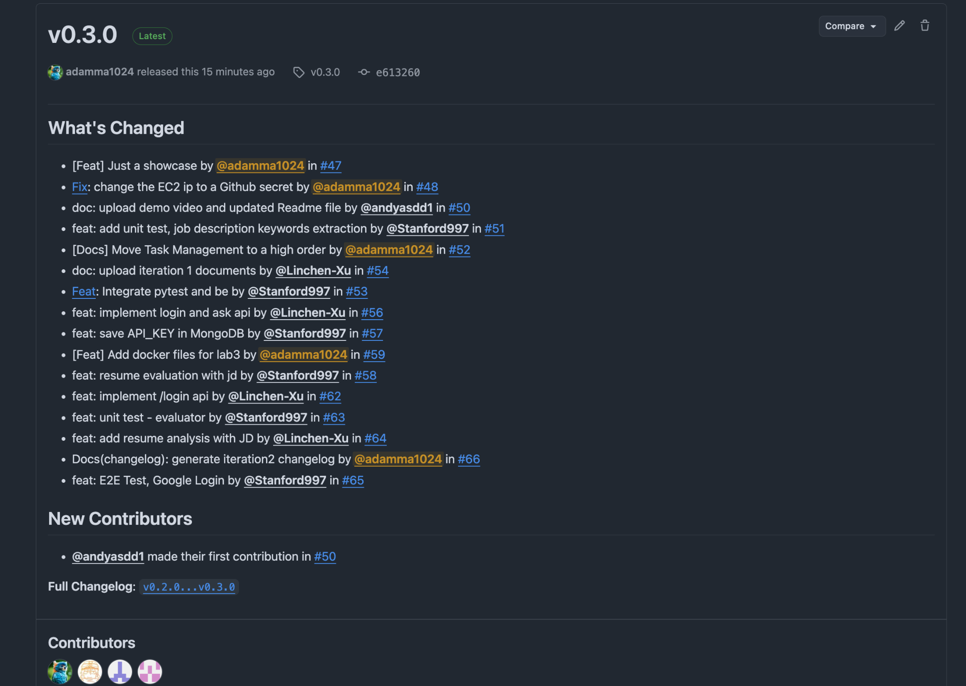
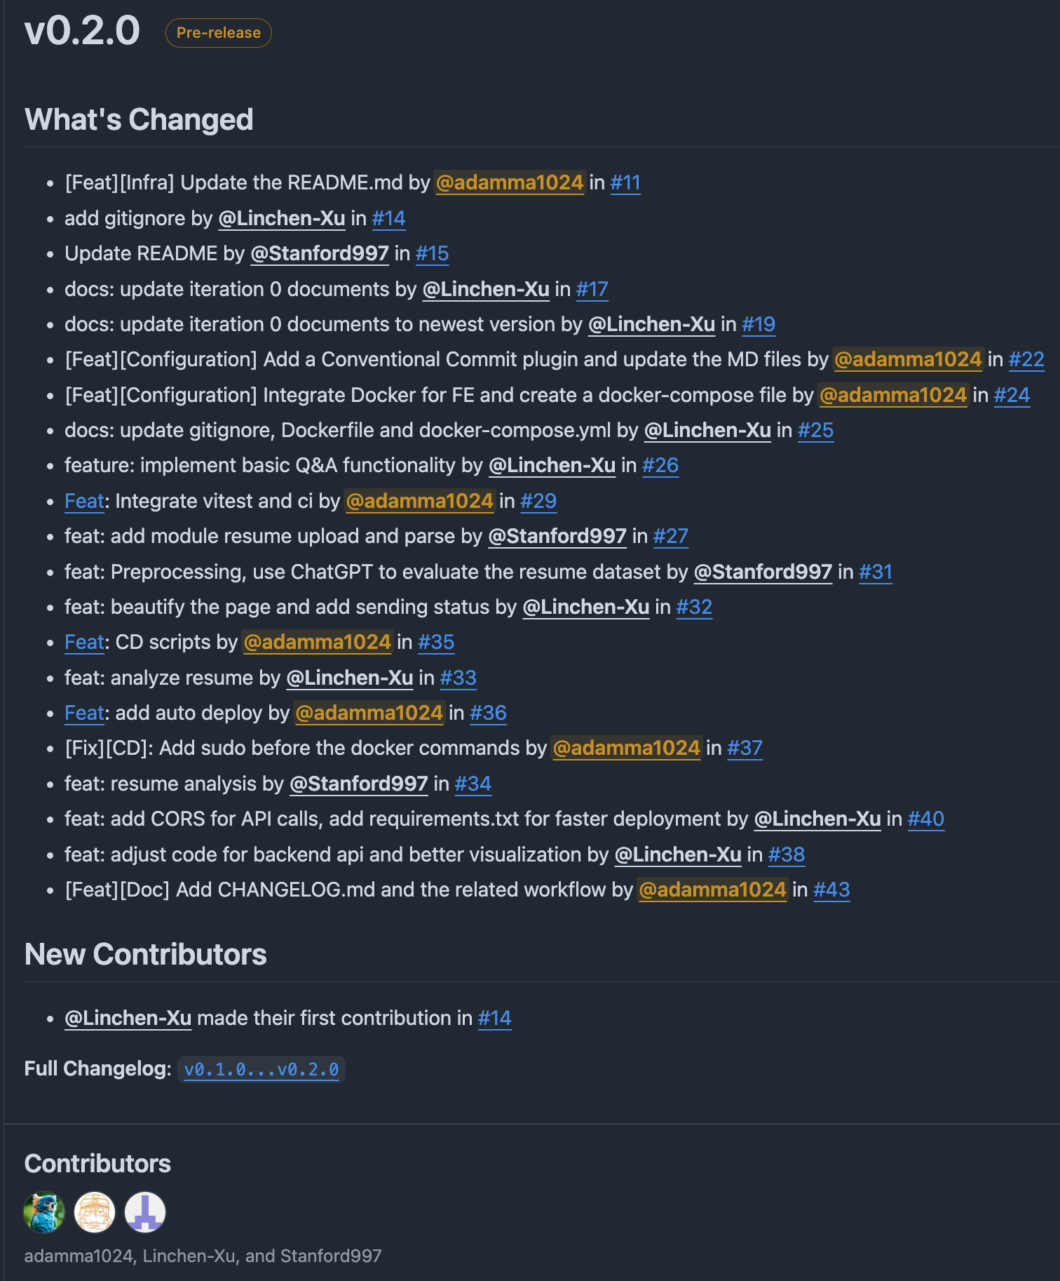
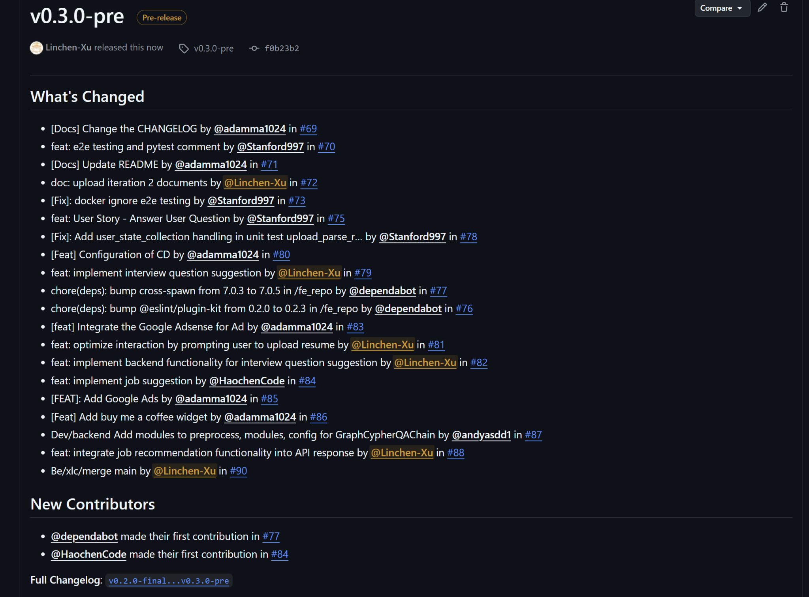
PRs
76 PRs in total

Slide 32
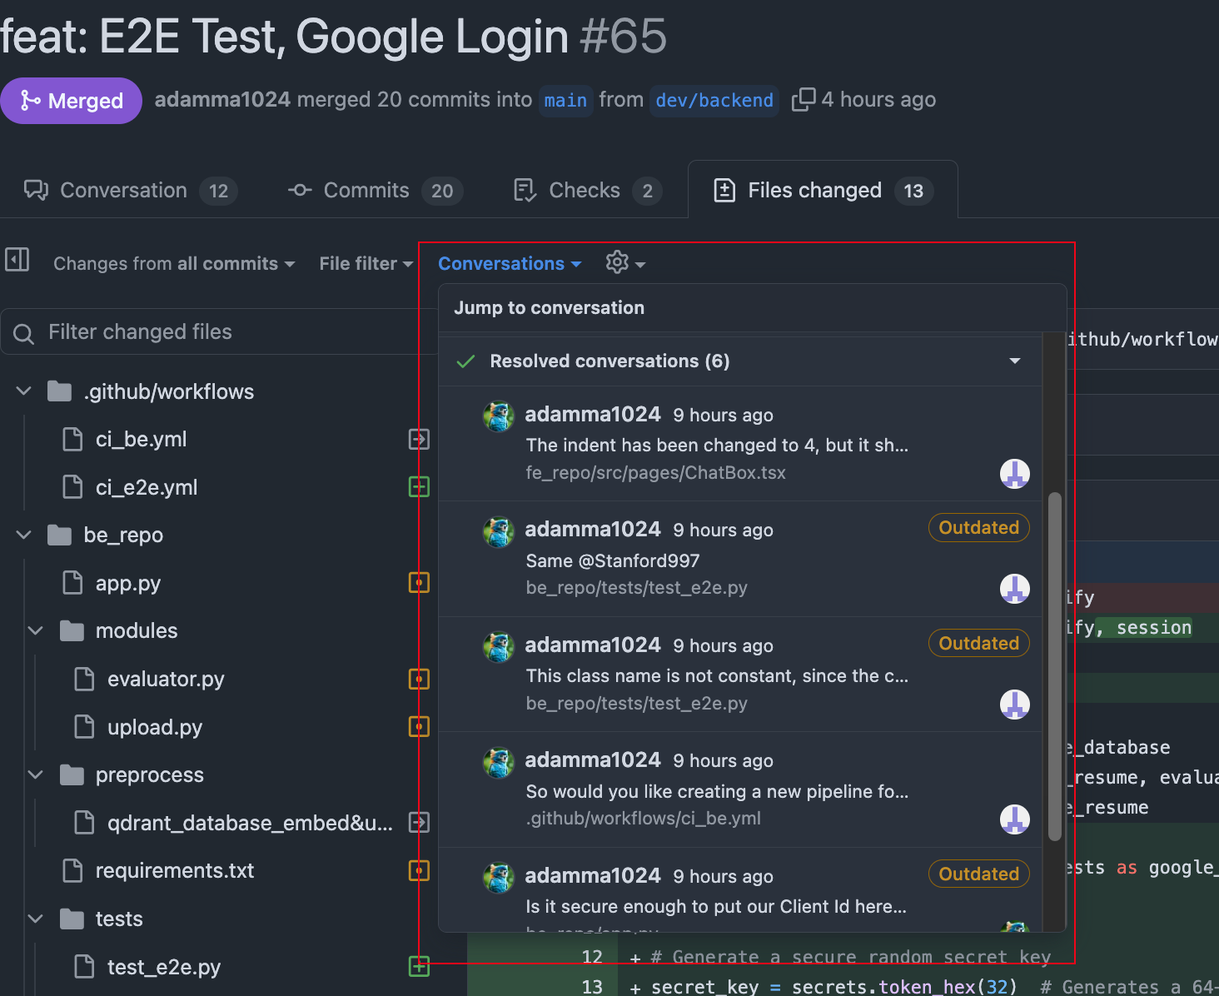
Code Review
For each PR, there is at least one reviewer to review.
And the comments are blockers avoiding checking in bad smell codes.

Slide 33
Demo
cvcoach.site

